Slide 1
EX:sp{Lore}
Exploration Game

Slide 2
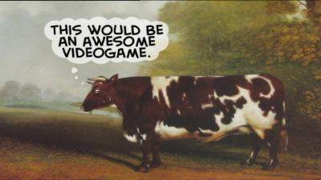
Idea
Exploration: of an environment
Experience
Spell Points
Lore

Slide 3
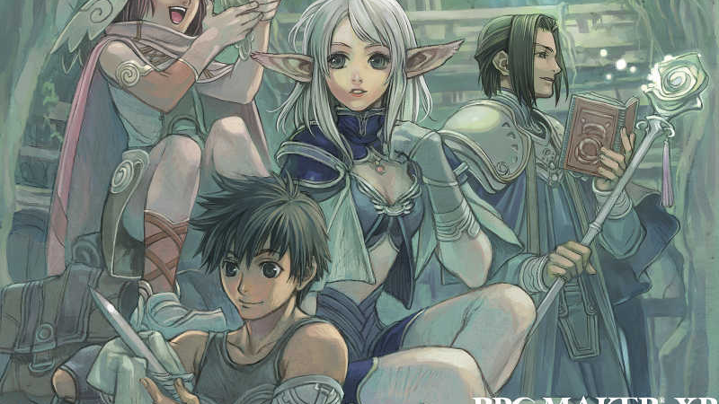
Inspiration
Fantasy, Syfy RPG

Slide 4
AI
Director AI
Pathfinding
Consider FSM

Slide 5
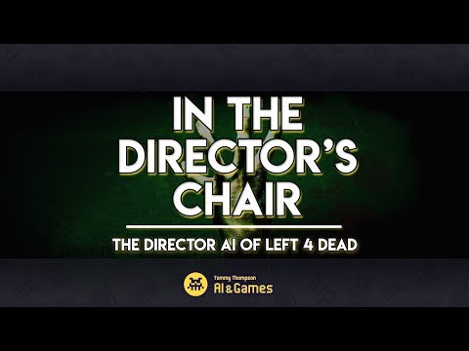
Director AI
Focus: one direction mechanics of the entire game through the AI.
Considering how to implement?

Slide 6
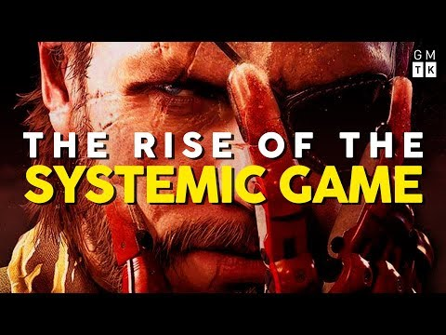
Systemic Game
Focus: Behavioral AI of different class can interact with over NPC’s as well as environmental changes in the game world
Considering how to implement?

